Slide 1
16S Mouse Ayayee
GC
2/8/23

Slide 2
282 ASVs in entire dataset
rarefied to 1400 reads bc GF samples had low counts
rarefaction removed 111 ASVs,
Rarefied dataset has 171 ASVs

Slide 3
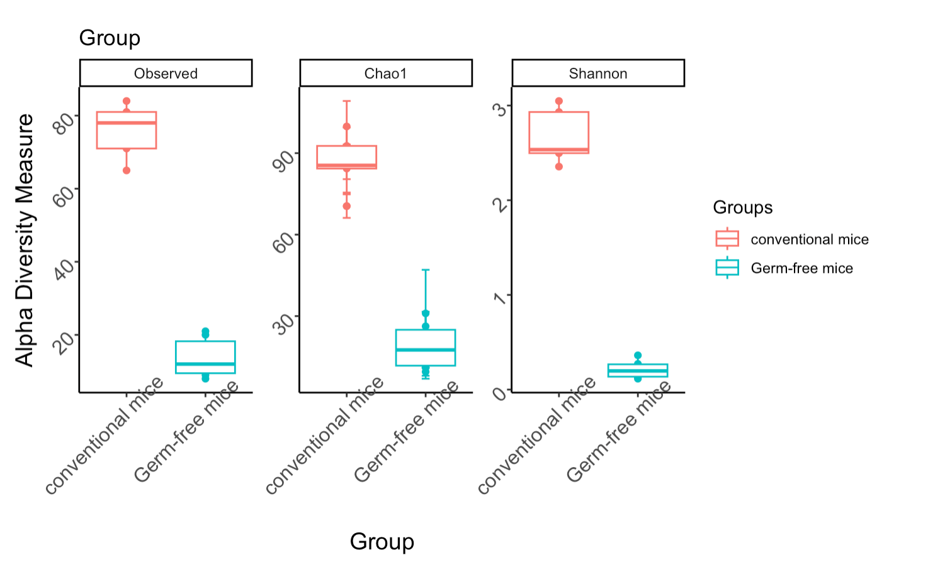
Kruskal-Wallis rank sum test data:
rich_dat$Shannon and rich_dat$Group
Kruskal-Wallis chi-squared = 7.5, df = 1, p-value = 0.00617

Slide 4
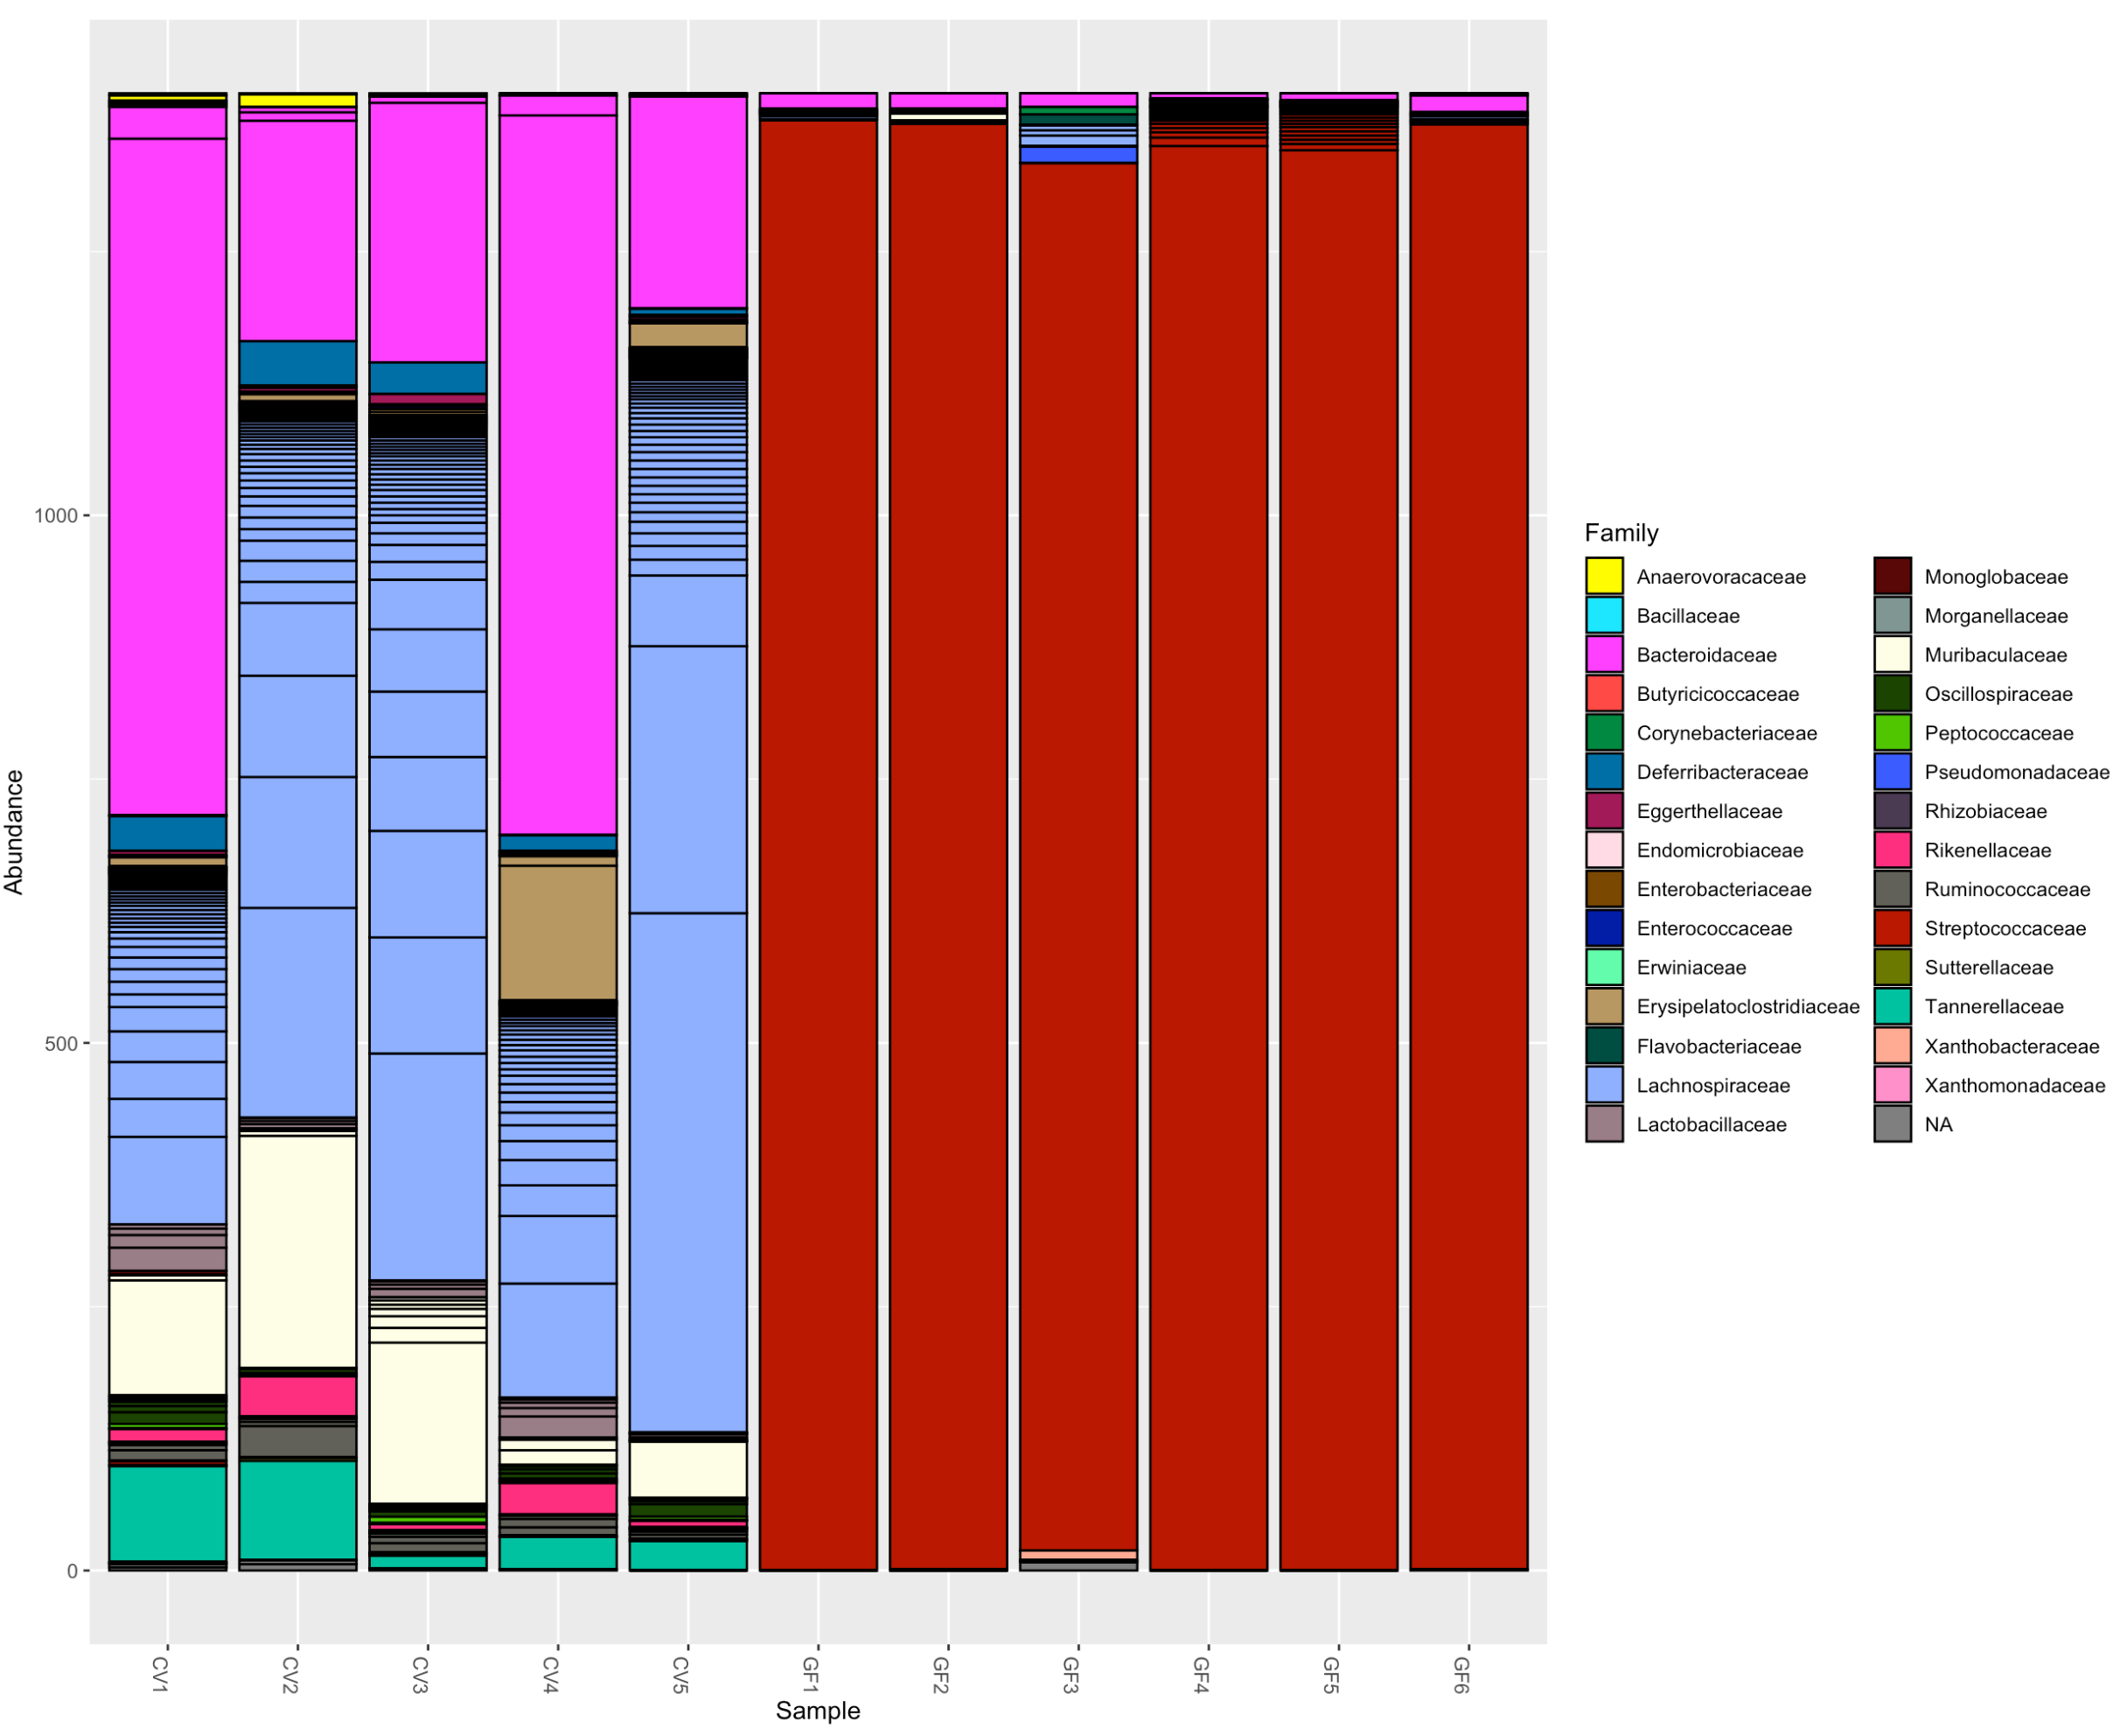

Slide 5
> adonis2(dist_w ~ Groups, data= sd_adonis, permutations = 10000)
Permutation test for adonis under reduced model
Terms added sequentially (first to last)
Permutation: free
Number of permutations: 10000
adonis2(formula = dist_w ~ Groups, data = sd_adonis, permutations = 10000)
Df SumOfSqs R2 F Pr(>F)
Groups 1 0.36756 0.8744 62.654 0.0038 **
Residual 9 0.05280 0.1256
Total 10 0.42036 1.0000
---
Signif. codes: 0 ‘***’ 0.001 ‘**’ 0.01 ‘*’ 0.05 ‘.’ 0.1 ‘ ’ 1
> adonis2(dist_uw ~ Groups, data= sd_adonis, permutations = 10000)
Permutation test for adonis under reduced model
Terms added sequentially (first to last)
Permutation: free
Number of permutations: 10000
adonis2(formula = dist_uw ~ Groups, data = sd_adonis, permutations = 10000)
Df SumOfSqs R2 F Pr(>F)
Groups 1 0.49843 0.16751 1.8109 0.08209 .
Residual 9 2.47717 0.83249
Total 10 2.97560 1.00000
---
Signif. codes: 0 ‘***’ 0.001 ‘**’ 0.01 ‘*’ 0.05 ‘.’ 0.1 ‘ ’ 1

Slide 6
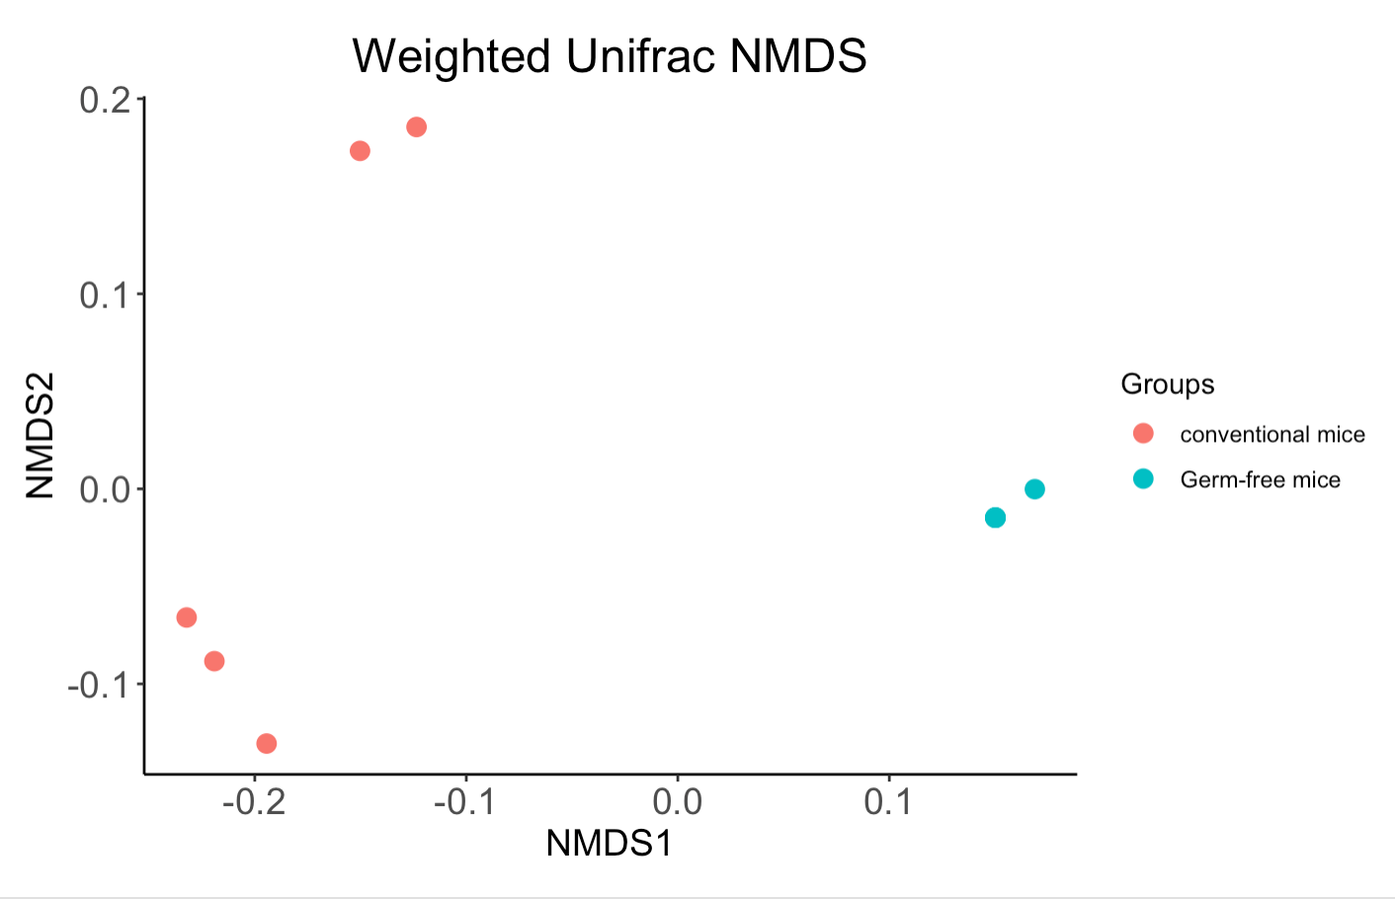
Ordination looks like there are missing samples, but they are essentially identical.
> ord_plot
$sites
NMDS1 NMDS2
CV1 -0.4872674 0.71301479
CV2 -0.6887961 -0.39478531
CV3 -0.6885675 -0.39572908
CV4 -0.4867408 0.71361215
CV5 -0.6886848 -0.39541468
GF1 0.5066586 -0.04010131
GF2 0.5066645 -0.04010320
GF3 0.5066599 -0.04012822
GF4 0.5066337 -0.04011160
GF5 0.5067486 -0.04013458
GF6 0.5066913 -0.04011898

Slide 7
PICRUST2
Kruskal-Wallis
p < 0.005, 259 KOs differentially abundant between Groups
p < 0.01, 178 Pathways differentially abundant between Groups
p < 0.005, 79 ECs differentially abundant between Groups

